Slide 1
Weekly report: Feedback & Lidar – Assisted Controller
Week number: 13
Date: 23/12/2025
Supervisor: Prof. Dr.-Ing. David Schlipf
Group members: Mirza Dincer, Saurabh Pankaj Jha, Midhun Kanichattu Venu
Presenter:

Slide 2
List of Contents
Rated Wind Speed
Steady States values
Torque Controller
Pitch Controller
Mirza Dincer

Slide 3
Tasks of the Week
Retuning of feedback controller with updated blade configuration
Mirza Dincer

Slide 4
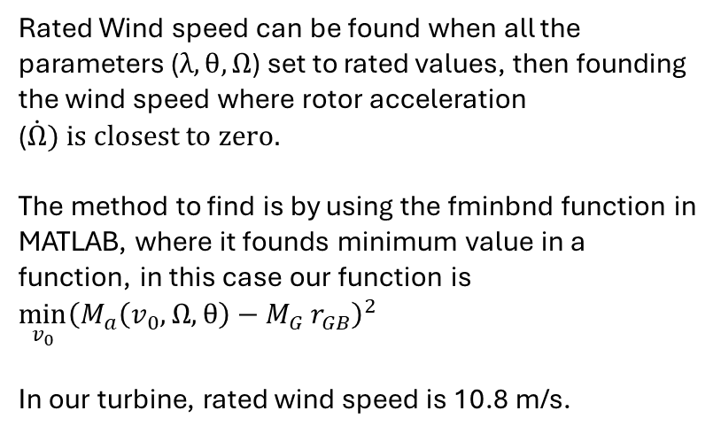
Rated Wind Speed
$$Rotor Motion: J \dot{Ω}=M_{a}−M_{G} r_{GB}$$
$${Aerodynamic Torque: M}_{a}=\frac{1}{2} ρ πR^{2} c_{P}\left(λ,θ\right) \frac{v_{\text{rel}}^{3}}{Ω}$$
Rated Wind speed can be found when all the parameters ($λ,θ,Ω$) set to rated values, then founding the wind speed where rotor acceleration ($\dot{Ω}) is closest to zero.$
The method to find is by using the fminbnd function in MATLAB, where it founds minimum value in a function, in this case our function is ${\min_{v_{0}}\left(M_{a}\left(v_{0},Ω,θ\right)−M_{G} r_{GB}\right)}^{2}$
In our turbine, rated wind speed is 10.8 m/s.

Slide 5
Steady States Simulation
600 seconds of simulation.
Wind speeds from 1 m/s to 30 m/s, with increments of 1 m/s
Only enabled Rotor DOF and First fore-aft tower bending-mode DOF.

Slide 6
Steady States
Rotational Speed [rpm]
Pitch Angles [deg]

Slide 7
Steady States
Generator Torque [kNm]
Tower Top Position [m]

Slide 8
Steady States
Static Power Curve

Slide 9
Power Coefficient
Maximum power coefficient is 0.43 at TSR = 9.7 and 0 deg.

Slide 10

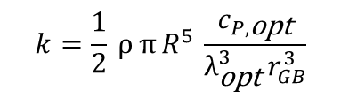
Torque Controller
$$k=\frac{1}{2} ρ π R^{5} \frac{c_{P,\text{opt}}}{λ_{\text{opt}}^{3} r_{GB}^{3}}$$
$$M_{G}=k Ω_{G}^{2}$$
K value shows the relation between generator torque and generator speed for region 2.
To find the best k value, we optimized for highest power generated at a region 2 wind speed, in this case 6.5 m/s.
Starting point is 1.4273 Nm/(rad/s^2), which is the value obtained by max Cp point (0. 43 in theta = 0° and TSR = 97).
1.9273 Nm/(rad/s^2) gives the highest power.

Slide 11
Simulation Settings for Step Response
300 seconds of simulation, to see settled values for both wind speeds.
Step wind speed, from 6 m/s to 7 m/s.
Only enabled Rotor DOF and First fore-aft tower bending-mode DOF.
Initial conditions of rotor speed and fore-aft tower top displacement.

Slide 12
Torque Controller PI Controller
In step response of a wind turbine for below rated, we need a behavior of slightly damped (D = 0.7), and natural frequency of 2 -3 times slower than rated rotational speed.
Starting Kp chosen same as IEA 3.4 MW,
Kp = 961 [Nm/(rad/s)].
Ki = Kp / Ti, where Ti = 6 s.
In the figure, we compare the step response of different Kp values from 6 m/s to 7 m/s.
It is seen that as we increase the Kp, we get a better behavior.
Kp is chosen as 1400 [Nm/(rad/s)].

Slide 13
Step Responses
Step response simulation from 6 to 7 m/s. Controller keeps the TSR constant for region 2.

Slide 14
Step Responses
Step response simulation for 15 to 16 m/s.
Controller keeps the rotational speed constant for region 3.

Slide 15
Simulation Settings for Pitch Optimization
660 seconds of simulation. Evaluation of values starts at t = 60 second to get settled values. Additionally, wind wraps around.
DLC 1.2 wind fields with average of 8 m/s to 24 m/s with steps with 4m/s, 3 seeds.
Enabled all DOFs.
Initial conditions of pitch angle, rotor speed and fore-aft tower position for every corresponding wind speed.
Mirza Dincer

Slide 16
Pitch Optimization
It is seen that the point Kp = -0.012 s and theta = 14° gives the lowest DEL, such that differences in AEP can be ignored because they are too small.
Mirza Dincer

Slide 17
Conclusion
Feedback controller is ready for Optimus Syria
Continue and finish adjusting the Lidar-Assisted Controller
Mirza Dincer

